Slide 1
Professor: Steve Haga
Office: EC9037
Office Hours: Monday 12:00-2:00
Friday 10:00-12:00
Email: stevewhaga@yahoo.com
(Please write the subject heading in Me.)
TA: ???
Email:
Office:
Office Hours:
Sometimes
in EC5012,
not EC9037.

Slide 2
Course Requirements
Midterm
Final
Class Attendance Participation and Quizzes
Programming Assignments

Slide 3
There are many reasons to learn UNIX/Linux:
Quicker to perform tasks than Windows
But harder to learn
Fewer viruses
Mostly because less popular
More research software
But less consumer software
Used a lot in:
Servers, laboratories, embedded systems, low budget systems (because it is free)

Slide 4
There are many reasons to learn UNIX/Linux:
Quicker to perform tasks than Windows
But harder to learn
Fewer viruses
Mostly because less popular
More research software
But less consumer software
Used a lot in:
Servers, laboratories, embedded systems, low budget systems (because it is free)
Doesn’t this sound like a good reason for you to want to learn UNIX?
Can you really be a computer scientist if you don’t know UNIX?

Slide 5
There are many reasons to learn UNIX/Linux:
Quicker to perform tasks than Windows
But harder to learn
Fewer viruses
Mostly because less popular
More research software
But less consumer software
Used a lot in:
Servers, laboratories, embedded systems, low budget systems (because it is free)
This is why the school makes you take an entire course on UNIX.
And it is why this course is not easy. You must do your programming assignments.

Slide 6
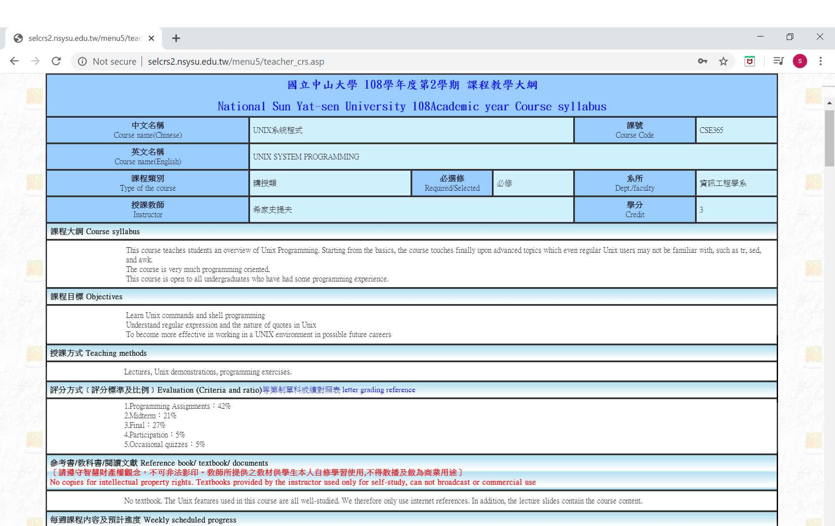
/ CSE662
You can only learn programming by coding actual programs.
If you aren’t planning to do your assignments, then you are planning to fail.

Slide 7
And don’t plan on copying another student’s work either…
If you cheat, one of two things will happen:
You’ll get caught (so both the copier and the helper directly fail the entire course).
You won’t get caught but won’t learn, so: - You’ll probably fail the exams. - You’ll miss out on the chance to learn
a life skill that can let you henceforth do things quicker.
- You’ll not be prepared for the workplace.
You can only learn programming by coding actual programs.
If you aren’t planning to do your assignments, then you are planning to fail.

Slide 8
There are many reasons to learn UNIX/Linux:
Quicker to perform tasks than Windows
But harder to learn
Fewer viruses
Mostly because less popular
More research software
But less consumer software
Used a lot in:
Servers, laboratories, embedded systems, low budget systems (because it is free)
If you cheat, one of two things will happen:
You’ll get caught (so both the copier and the helper directly fail the entire course).
You won’t get caught but won’t learn, so: - You’ll probably fail the exams. - You’ll miss out on the chance to learn
a life skill that can let you henceforth do things quicker.
- You’ll not be prepared for the workplace.
- You’ll miss out on the chance to learn
a life skill that can let you henceforth do things quicker.
- You’ll not be prepared for the workplace.

Slide 9
There are many reasons to learn UNIX/Linux:
Quicker to perform tasks than Windows
But harder to learn
Fewer viruses
Mostly because less popular
More research software
But less consumer software
Used a lot in:
Servers, laboratories, embedded systems, low budget systems (because it is free)
- You’ll miss out on the chance to learn
a life skill that can let you henceforth do things quicker.
- You’ll not be prepared for the workplace.

Slide 10
Course Outline
Basic UNIX Commands
cd, ls, mkdir, rmdir, cp, mv, cat, less, echo, history, etc.
More complex UNIX Commands
cut, diff, tr, expr, xargs, etc.
Redirection and Pipes
UNIX Shell Wildcard Patterns
UNIX Shell Quoting Rules
Regular Expression Patterns (grep)
Extended Regular Expression Patterns (egrep)
C Shell Programming
The sed Command
The awk Command
Items that we probably won’t have time to cover
Makefiles, lex and yacc grammars, the bash shell

Slide 11
Using the Command Line
GUIs (Graphical User Interfaces) are available and often used on Linux systems.
But you must know the command line utilities, pipes, and I/O redirection in order to create UNIX script programs.
Once you learn the UNIX command line, you often prefer it to the GUI, because it is so flexible and powerful.

Slide 12
The Unix Philosophy:
To provide tools that each do one thing well.
To let you combine these tools together to form more powerful Unix commands.
To view all communication as being via files.
Each tool can take input from one file and put its output into another file.
A file is modeled as just a character stream; it doesn’t have to be actually stored on disk.
Eg, the keyboard input & screen output.

Slide 13
Introducing Unix Commands
You issue commands from a command prompt.
Commands have:
A name
Optional flags
Arguments
For example, cat (short for concatenate, 串接) is a command to join a set of files to one output stream:
cat filename <-- just displays the file

Slide 14
Introducing Unix Commands
You issue commands from a command prompt.
Commands have:
A name
Optional flags
Arguments
For example, cat (short for concatenate, 串接) is a command to join a set of files to one output stream:
cat -n filename <-- with line numbers
Commands are typed in lowercase (小寫), so: cat is different than Cat or CAT

Slide 15
Commands for Viewing Files
cat <filename> - Display a file on screen cat -n <filename> - Display with line numbers

Slide 16
Commands for Viewing Files
cat <filename> - Display a file on screen cat -n <filename> - Display with line numbers
more <filename> - To see a screenful at a time

Slide 17
Commands for Viewing Files
cat <filename> - Display a file on screen cat -n <filename> - Display with line numbers
more <filename> - To see a screenful at a time
less <filename> - A better version of more
(A pun (雙關語) of the adage (諺語): less is often better than more)

Slide 18
Commands for Viewing Files
cat <filename> - Display a file on screen cat -n <filename> - Display with line numbers
more <filename> - To see a screenful at a time
less <filename> - A better version of more
(A pun (雙關語) of the adage (諺語): less is often better than more)
head <filename> - Display the first 10 lines of a file.
head -n <filename>- Displays the first n lines.

Slide 19
Commands for Viewing Files
cat <filename> - Display a file on screen cat -n <filename> - Display with line numbers
more <filename> - To see a screenful at a time
less <filename> - A better version of more
(A pun (雙關語) of the adage (諺語): less is often better than more)
head <filename> - Display the first 10 lines of a file.
head -n <filename>- Displays the first n lines.
tail <filename> - Display the last 10 lines of a file.
tail -n <filename> - Displays the last n lines.

Slide 20
Commands for Viewing Files
cat <filename> - Display a file on screen cat -n <filename> - Display with line numbers
more <filename> - To see a screenful at a time
less <filename> - A better version of more
(A pun (雙關語) of the adage (諺語): less is often better than more)
head <filename> - Display the first 10 lines of a file.
head -n <filename>- Displays the first n lines.
tail <filename> - Display the last 10 lines of a file.
tail -n <filename> - Displays the last n lines.
paste <filenames> - Display the files in columns. paste -d <string> <files> - Use character(s) of <string> as column delimiters (定界符)

Slide 21
Commands for Viewing Files
Commands which Can Be Useful,
But which I Won't Put on the Exam:
tac <filename> - Display file upside-down (cat→tac).
rev <filename> - Display each line reversed.
fold <filename> - Display with text-width wrapping.
join <sortedfile> <sortedfile> - Join and display lines that share a key. (default key is the line's first word).

Slide 22
Commands for Viewing Files
Viewing Files
cat <filename> - Display a file on screen cat -n <filename> - Display with line numbers
more <filename> - To see a screenful at a time
less <filename> - A better version of more
(A pun (雙關語) of the adage (諺語): less is often better than more)
head <filename> - Display the first 10 lines of a file.
head -n <filename>- Displays the first n lines.
tail <filename> - Display the last 10 lines of a file.
tail -n <filename> - Displays the last n lines.
paste <filenames> - Display the files in columns. paste -d <string> <files> - Use character(s) of <string> as column delimiters (定界符)
For Viewing File Names that are in a Directory, use “ls” (list).

Slide 23
File Names
File names are CaSe sEnSiTiVe
It is unwise to use file names that contain:
spaces ( )
commas (,)
question marks (?)
stars (*)
dollars ($)
forward slashes (/)
backwards slashes (\)

Slide 24
Changing Directories
pwd | Print the working directory (ie, the directory you're currently working in).
cd <path> | Change directory to path. The path can be relative or absolute: cd /home/steve/subdir ← absolute path cd ~/subdir ← absolute from your home cd ../subdir2 ← relative to where you are There are also ways to not give a path: cd ← equivalent to “cd ~” cd - ← go back to your previous pwd (Your path when you type this will become the new previous, so you can't go back farther.)

Slide 25
A Simple Unix Directory Structure
/
usr
etc
home
bin
var
...
local
bin
...
bill
steve
alice
...
subdir1
subdir2
...

Slide 26
Special Directories
The Root Directory
/
The Home Directory (These are all equivalent) :
/home/steve
~steve
~
A user generally has permission to access files within that user’s home directory and its children.
Users start with their home directory as their current directory when they login.

Slide 27
Absolute & Relative Paths
Absolute:
every file has 1 -- and only 1 -- absolute path
starts with a “/” as the first character
“/” is the root
Comparable addressing exists in Windows
can use “~” to start the path at the user level
Relative:
describe path from current working directory
Single dot (.) is the current directory
Double dot (..) is the parent directory
Comparable addressing exists in Windows

Slide 28
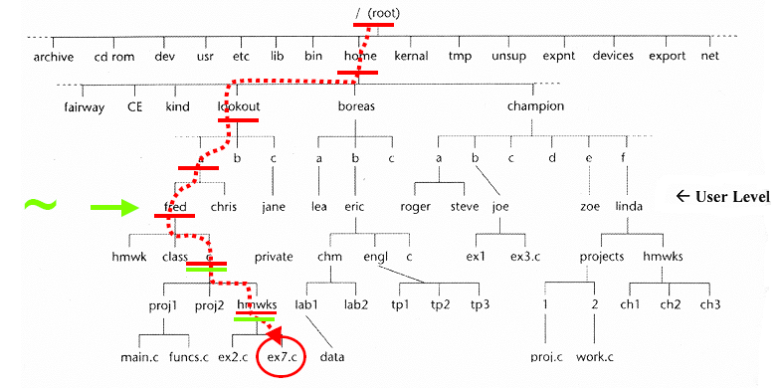
Absolute addressing
Absolute address of file ex7.c: /home/lookout/a/fred/c/hmwrks/ex7.c
With the ~ shortcut: ~/c/hmwrks/ex7.c

Slide 29
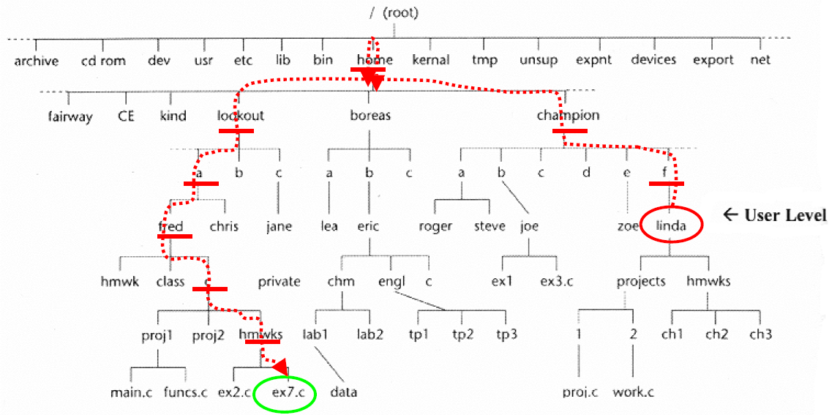
Relative addressing
Relative address, if your working directory is “linda”:
../../../../home/lookout/a/fred/c/hmwrks/ex7.c
or better would be: ../../../lookout/a/fred/c/hmwrks/ex7.c

Slide 30
Changing Directories
pwd | Print the working directory (ie, the directory you're currently working in).
cd <path> | Change directory to path. The path can be relative or absolute: cd /home/steve/subdir ← absolute path cd ~/subdir ← absolute from your home cd ../subdir2 ← relative to where you are There are also ways to not give a path: cd ← equivalent to “cd ~” cd - ← go back to your previous pwd (Your path when you type this will become the new previous, so you can't go back farther.)

Slide 31
Navigating in Unix
To move from a child to a parent directory: cd ..
PARENT
CHILD

Slide 32
Navigating in Unix
To move from a grandchild to a grandparent directory: cd ../..
PARENT
CHILD
GRANDCHILD

Slide 33
Navigating in Unix
To move from a child to a sibling directory: cd ../CHILD2
PARENT
CHILD
CHILD2

Slide 34
Changing Directories
pwd | Print the working directory (ie, the directory you're currently working in).
cd <path> | Change directory to path. The path can be relative or absolute: cd /home/steve/subdir ← absolute path cd ~/subdir ← relative to your home cd ../subdir2 ← relative to where you are There are also ways to not give a path: cd ← equivalent to “cd ~” cd - ← go back to your previous pwd (Your path when you type this will become the new previous, so you can't go back farther.)
Note: This slide is animated

Slide 35
File Creation and Deletion
cp (-p) | Copies files
mv | Moves files
rm (-iIfr) | Deletes files
mkdir | Makes a directory
rmdir | Removes a directory
rm -r | Removes a directory and everything below it -- even if not empty

Slide 36
File Creation and Deletion
cp (-p) | Copies files
mv | Moves files
rm (-iIfr) | Deletes files
mkdir | Makes a directory
rmdir | Removes a directory
rm -r | Removes a directory and everything below it -- even if not empty

Slide 37
The Unix Copy Command
cp can be used to make a copy of a file, leaving the original file untouched.
Syntax:
cp [path/]oldfile [path/]newfile

Slide 38
The Unix Copy Command
To make a copy of a file if both the original and copy are in the same directory.
Syntax:
cp index.html home.html

Slide 39
The Unix Copy Command
To make a copy of a file which retains the original’s name, but goes into a different directory:
cp index.html ../subdir/

Slide 40
The Unix Copy Command
To make a copy of a file which gets a new name and goes into a different directory:
cp index.html ../subdir/home.html

Slide 41
The Unix Copy Command
To copy multiple files, do the following. The final argument must be a directory (otherwise it would not make sense):
cp f1 f2 otherfile ../subdir/

Slide 42

Specifying filenames with Wildcards
Wildcards (萬用字元) are special symbols that can substitute for multiple things.
The term comes from poker terminology (撲克術語):
The joker can be substituted for any card you want – it is actually called a “wildcard”.
In UNIX, there 2 normal wildcard symbols:
? – Fills the place of any one character (like the joker)
* – Fills the place of any number of characters (including zero)

Slide 43
Specifying filenames with Wildcards
Wildcards (萬用字元) are special symbols that can substitute for multiple things.
The term comes from poker terminology (撲克術語):
The joker can be substituted for any card you want – it is actually called a “wildcard”.
In UNIX, there 2 normal wildcard symbols:
? – Fills the place of any one character (like the joker)
* – Fills the place of any number of characters (including zero)
You can restrict the wildcard to match only a subset of characters with [...].

Slide 44
The * and ? Wildcards
ls a* - All files starting with 'a'
ls *a* - All filenames with 'a' in them
ls *a*html - All filenames with 'a' in them and ending with html
ls ????? - All 5 character filenames

Slide 45
The […] and [^…] Wildcards
ls [abc]* - All filenames starting with a, b, or c
ls [a-c]* - Same as above but done as a range
ls [^a-c]* - All filenames not starting with a, b, or c

Slide 46
Understanding Wildcards
Suppose we type: ls f*
and we get:
This tells us that three files in our current directory begin with an “f”
Now, suppose we type:
cp f* f*
then we get:
cp: target `funfile’ is not a directory
We want to understand what just happened. The UNIX operating system has replaced each f* with what it really is
file1 file2 funfile

Slide 47
Understanding Wildcards
Suppose we type: ls f*
and we get:
This tells us that three files in our current directory begin with an “f”.
Now, suppose we type:
cp f* f*
then we get:
cp: target `funfile’ is not a directory
We want to understand what just happened. The UNIX operating system has replaced each f* with what it really is
file1 file2 funfile

Slide 48
Understanding Wildcards
Suppose we type: ls f*
and we get:
This tells us that three files in our current directory begin with an “f”.
Now, suppose we type:
then we get:
cp: target `funfile’ is not a directory
We want to understand what just happened. The UNIX operating system has replaced each f* with what it really is
file1 file2 funfile
cp
f*
f*

Slide 49
Understanding Wildcards
Suppose we type: ls f*
and we get:
This tells us that three files in our current directory begin with an “f”.
Now, suppose we type:
then we get:
cp: target `funfile’ is not a directory
We want to understand what just happened. The UNIX operating system has replaced each f* with what it really is
file1 file2 funfile
cp
f*
f*

Slide 50
Understanding Wildcards
Suppose we type: ls f*
and we get:
This tells us that three files in our current directory begin with an “f”.
Now, suppose we type:
then we get:
cp: target `funfile’ is not a directory
We want to understand what just happened.
The UNIX operating system has replaced each f*
with what it really is.
file1 file2 funfile
file1 file2 funfile
cp
cp
f*
f*
f*
f*

Slide 51
Understanding Wildcards
Suppose we type: ls f*
and we get: file1 file2 funfile
This tells us that three files in our current directory begin with an “f”.
Now, suppose we type:
f* f*
then we get:
cp: target `funfile’ is not a directory
We want to understand what just happened.
The UNIX operating system has replaced each f*
with what it really is.
file1 file2 funfile
cp
f*
f*
f*

Slide 52
Understanding Wildcards
Suppose we type: ls f*
and we get:
This tells us that three files in our current directory begin with an “f”.
Now, suppose we type:
then we get:
cp: target `funfile’ is not a directory
We want to understand what just happened.
The UNIX operating system has replaced each f*
with what it really is.
file1 file2 funfile
file1 file2 funfile
file1 file2 funfile
cp
file1 file2 funfile
file1 file2 funfile
f*
f*

Slide 53
Understanding Wildcards
Suppose we type: ls a*
and we get: aa ab adirectory
This tells us that three “things” in our current directory begin with an “a”. The third among them is not a file.
Now, suppose we type:
cp a* a*f*
then we get:
cp: omitting directory `a3’
cp: warning: source file `a1’ specified more than once
cp: warning: source file `a2’ specified more than once
Why?

Slide 54
Understanding Wildcards
Suppose we type: ls a*
and we get: aa ab adirectory
This tells us that 3 “things” in our current directory begin with “a”. The name of one suggest it is a directory.
Now, suppose we type:
cp a* a*f*
then we get:
cp: omitting directory `a3’
cp: warning: source file `a1’ specified more than once
cp: warning: source file `a2’ specified more than once
Why?

Slide 55
Understanding Wildcards
Suppose we type: ls a*
and we get: aa ab adirectory
This tells us that 3 “things” in our current directory begin with “a”. The name of one suggest it is a directory.
Now, suppose we type:
cp a* a*
Then we get:
cp: omitting directory `adirectory’
cp: warning: source file `aa’ specified more than once
cp: warning: source file `ab’ specified more than once
Why?

Slide 56
Understanding Wildcards
Suppose we type: ls a*
and we get: aa ab adirectory
This tells us that 3 “things” in our current directory begin with “a”. The name of one suggest it is a directory.
Now, suppose we type:
cp a* a*
Then we get:
cp: omitting directory `adirectory’
cp: warning: source file `aa’ specified more than once
cp: warning: source file `ab’ specified more than once
Why?

Slide 57
Understanding Wildcards
Suppose we type: ls a*
and we get: aa ab adirectory
This tells us that 3 “things” in our current directory begin with “a”. The name of one suggest it is a directory.
Now, suppose we type:
cp a* a*
Then we get:
cp: omitting directory `adirectory’
cp: warning: source file `aa’ specified more than once
cp: warning: source file `ab’ specified more than once
Why?

Slide 58
Understanding Wildcards
Suppose we type: ls a*
and we get: aa ab adirectory
This tells us that 3 “things” in our current directory begin with “a”. The name of one suggest it is a directory.
Now, suppose we type:
cp a* a*
Then we get:
cp: omitting directory `adirectory’
cp: warning: source file `aa’ specified more than once
cp: warning: source file `ab’ specified more than once
Why?

Slide 59
Understanding Wildcards
Suppose we type: ls a*
and we get: aa ab adirectory
This tells us that 3 “things” in our current directory begin with “a”. The name of one suggest it is a directory.
Now, suppose we type:
cp aa ab adirectory
Then we get:
cp: omitting directory `adirectory’
cp: warning: source file `aa’ specified more than once
cp: warning: source file `ab’ specified more than once
Why?
adirectory
aa
ab

Slide 60
Understanding Wildcards
Suppose we type: ls a*
and we get: aa ab adirectory
This tells us that 3 “things” in our current directory begin with “a”. The name of one suggest it is a directory.
Now, suppose we type:
cp aa ab aa ab adirectory
Then we get:
cp: omitting directory `adirectory’
cp: warning: source file `aa’ specified more than once
cp: warning: source file `ab’ specified more than once
Why?
It makes no sense to copy a directory (cp works on files). So cp will ignore this.
adirectory
aa
ab

Slide 61
Understanding Wildcards
Suppose we type: ls a*
and we get: aa ab adirectory
This tells us that 3 “things” in our current directory begin with “a”. The name of one suggest it is a directory.
Now, suppose we type:
cp aa ab ab adirectory
Then we get:
cp: omitting directory `adirectory’
cp: warning: source file `aa’ specified more than once
cp: warning: source file `ab’ specified more than once
Why?
aa
ab
You can copy a file twice, if you want, but it has no effect. The second one is dropped.

Slide 62
Understanding Wildcards
Suppose we type: ls a*
and we get: aa ab adirectory
This tells us that 3 “things” in our current directory begin with “a”. The name of one suggest it is a directory.
Now, suppose we type:
cp aa ab adirectory
Then we get:
cp: omitting directory `adirectory’
cp: warning: source file `aa’ specified more than once
cp: warning: source file `ab’ specified more than once
Why?
ab
Same thing for a different file.

Slide 63
Understanding Wildcards
Suppose we type: ls a*
and we get: aa ab adirectory
This tells us that 3 “things” in our current directory begin with “a”. The name of one suggest it is a directory.
Now, suppose we type:
cp aa ab adirectory
Then we get:
cp: omitting directory `adirectory’
cp: warning: source file `aa’ specified more than once
cp: warning: source file `ab’ specified more than once
So what did “cp a* a*” actually do?
It copies the aa and ab files into adirectory

Slide 64
File Creation and Deletion
cp (-p) | Copies files
mv | Moves files
rm (-iIfr) | Deletes files
mkdir | Makes a directory
rmdir | Removes a directory
rm -r | Removes a directory and everything below it -- even if not empty
This flag preserves the original file’s date

Slide 65
File Creation and Deletion
cp (-p) | Copies files
mv | Moves files
rm (-iIfr) | Deletes files
mkdir | Makes a directory
rmdir | Removes a directory
rm -r | Removes a directory and everything below it -- even if not empty

Slide 66
mv
To move a file from one directory to another: mv index.html ../other/
To rename a file (stays in the same directory): mv index.html home.html
To move a file and rename it at the same time: mv index.html ../other/home.html

Slide 67
File Creation and Deletion
cp (-p) | Copies files
mv | Moves files
rm (-iIfr) | Deletes files
mkdir | Makes a directory
rmdir | Removes a directory
rm -r | Removes a directory and everything below it -- even if not empty

Slide 68
File Creation and Deletion
cp (-p) | Copies files
mv | Moves files
rm (-iIfr) | Deletes files
mkdir | Makes a directory
rmdir | Removes a directory
rm -r | Removes a directory and everything below it -- even if not empty

Slide 69
rm
Q:How can we change the default settings?
A: Modify startup files.
To delete a single file: rm index.html (answer Y to confirm delete, if it asks)
(whether it asks depends on your settings)
To force that you will not be asked:
rm –f index.html
To ensure that you will be asked, interactively: rm –i *.html
rm -I *.html
Prompts before every removal
Prompts only once and only when removing 3 or more

Slide 70
File Creation and Deletion
cp (-p) | Copies files
mv | Moves files
rm (-iIfr) | Deletes files
mkdir | Makes a directory
rmdir | Removes a directory
rm -r | Removes a directory and everything below it -- even if not empty

Slide 71
File Creation and Deletion
cp (-p) | Copies files
mv | Moves files
rm (-iIfr) | Deletes files
mkdir | Makes a directory
rmdir | Removes a directory
rm -r | Removes a directory and everything below it -- even if not empty
Behaves as you would expect.

Slide 72
File Creation and Deletion
cp (-p) | Copies files
mv | Moves files
rm (-iIfr) | Deletes files
mkdir | Makes a directory
rmdir | Removes a directory
rm -r | Removes a directory and everything below it -- even if not empty
The directory must be empty.

Slide 73
File Creation and Deletion
cp (-p) | Copies files
mv | Moves files
rm (-iIfr) | Deletes files
mkdir | Makes a directory
rmdir | Removes a directory
rm -r | Removes a directory and everything below it -- even if not empty

Slide 74
rm -r
To delete a directory and all its subdirectories: rm –r directoryName
Please note that UNIX gives you great power.
But Spiderman's uncle Ben reminds us that with great power comes great responsibility.
DO NOT TYPE THIS: rm –r ~
Just 7 characters and now everything is gone (if your system’s rm defaults to -f).
(Things like this don’t happen in Windows, because Microsoft doesn’t trust you with power.)

Slide 75
Managing Files and Directories
ls (-lrtAS) | List the contents of a directory
ln -s | Create a symbolic link
chmod ua | Change file permissions
find . -name | Search for a file in a directory structure
diff -yWqc | Compare two files
fgrep (--color -invwoeABC) | Fixed string search
Notes:
75

Slide 76
Managing Files and Directories
ls (-lrtAS) | List the contents of a directory
ln -s | Create a symbolic link
chmod ua | Change file permissions
find . -name | Search for a file in a directory structure
diff -yWqc | Compare two files
fgrep (--color -invwoeABC) | Fixed string search
Notes:
76

Slide 77
The List Command
The list command (ls) shows the contents of a directory
We can add flags to the list command to modify what the command does
To use more than one flag, concatenate them: ls -lt

Slide 78
List Command Flags
ls -S sorts file listings by size.
ls -A shows all files (including hidden files).
Files whose names start with a ‘.’ are hidden.
I often use “ls -lrt”
This puts the most-recently modified files at the bottom, so they don’t scroll off (滾下) the screen:
ls -l shows files in long format, with details.
ls -t sorts file listings by last modified time.
ls -r shows file listings in reverse order.

Slide 79

% ls -lrt
total 122
-rw- r- - r- - 1 Me None 146 Feb 3 22:07 square.c
-rwxr-xr-x 1 Me None 160150 Feb 3 22:07 square.x
-rw- r- - r- - 1 Me None 5 Feb 3 22:09 AZZZ
-rw- r- - r- - 1 Me None 6 Feb 3 22:09 Aqrst.txt
-rw- r- - r- - 1 Me None 7 Feb 3 22:09 AFILE3
-rw- r- - r- - 1 Me None 7 Feb 3 22:09 AFILE2
-rw- r- - r- - 1 Me None 6 Feb 3 23:09 Afile
-rw- r- - r- - 1 Me None 4 Feb 3 22:09 ACE
-rw- r- - r- - 1 Me None 4 Feb 3 22:09 ABD.txt
-rw- r- - r- - 1 Me None 5 Feb 3 22:09 ABCD
-r w - r- - r- - 1 Me None 1449 Feb 3 22:10 APROG.c
-rwxr-xr-x 1 Me None 161473 Feb 3 22:10 APROG.x
-rw- r- - r- - 1 Me None 1486 Feb 3 22:14 tempfile2
-rw- r- - r- - 1 Me None 97 Feb 3 22:14 tempfile3
-rw- r- - r- - 1 Me None 70 Feb 3 22:15 tempfile4
-rw- r- - r- - 1 Me None 49 Feb 3 22:16 count_A_files
-rw- r- - r- - 1 Me None 49 Feb 12 23:54 count_files
Notes:
79

Slide 80
This is the file name
% ls -lrt
total 122
-rw- r- - r- - 1 Me None 146 Feb 3 22:07 square.c
-rwxr-xr-x 1 Me None 160150 Feb 3 22:07 square.x
-rw- r- - r- - 1 Me None 5 Feb 3 22:09 AZZZ
-rw- r- - r- - 1 Me None 6 Feb 3 22:09 Aqrst.txt
-rw- r- - r- - 1 Me None 7 Feb 3 22:09 AFILE3
-rw- r- - r- - 1 Me None 7 Feb 3 22:09 AFILE2
-rw- r- - r- - 1 Me None 6 Feb 3 23:09 Afile
-rw- r- - r- - 1 Me None 4 Feb 3 22:09 ACE
-rw- r- - r- - 1 Me None 4 Feb 3 22:09 ABD.txt
-rw- r- - r- - 1 Me None 5 Feb 3 22:09 ABCD
-r w - r- - r- - 1 Me None 1449 Feb 3 22:10 APROG.c
-rwxr-xr-x 1 Me None 161473 Feb 3 22:10 APROG.x
-rw- r- - r- - 1 Me None 1486 Feb 3 22:14 tempfile2
-rw- r- - r- - 1 Me None 97 Feb 3 22:14 tempfile3
-rw- r- - r- - 1 Me None 70 Feb 3 22:15 tempfile4
-rw- r- - r- - 1 Me None 49 Feb 3 22:16 count_A_files
-rw- r- - r- - 1 Me None 49 Feb 12 23:54 count_files
Notes:
80

Slide 81
This is the user name who owns the file. (The computer I was using had an account named “Me”.)
This is the file name
% ls -lrt
total 122
-rw- r- - r- - 1 Me None 146 Feb 3 22:07 square.c
-rwxr-xr-x 1 Me None 160150 Feb 3 22:07 square.x
-rw- r- - r- - 1 Me None 5 Feb 3 22:09 AZZZ
-rw- r- - r- - 1 Me None 6 Feb 3 22:09 Aqrst.txt
-rw- r- - r- - 1 Me None 7 Feb 3 22:09 AFILE3
-rw- r- - r- - 1 Me None 7 Feb 3 22:09 AFILE2
-rw- r- - r- - 1 Me None 6 Feb 3 23:09 Afile
-rw- r- - r- - 1 Me None 4 Feb 3 22:09 ACE
-rw- r- - r- - 1 Me None 4 Feb 3 22:09 ABD.txt
-rw- r- - r- - 1 Me None 5 Feb 3 22:09 ABCD
-r w - r- - r- - 1 Me None 1449 Feb 3 22:10 APROG.c
-rwxr-xr-x 1 Me None 161473 Feb 3 22:10 APROG.x
-rw- r- - r- - 1 Me None 1486 Feb 3 22:14 tempfile2
-rw- r- - r- - 1 Me None 97 Feb 3 22:14 tempfile3
-rw- r- - r- - 1 Me None 70 Feb 3 22:15 tempfile4
-rw- r- - r- - 1 Me None 49 Feb 3 22:16 count_A_files
-rw- r- - r- - 1 Me None 49 Feb 12 23:54 count_files
Notes:
81

Slide 82
This is the file size
% ls -lrt
total 122
-rw- r- - r- - 1 Me None 146 Feb 3 22:07 square.c
-rwxr-xr-x 1 Me None 160150 Feb 3 22:07 square.x
-rw- r- - r- - 1 Me None 5 Feb 3 22:09 AZZZ
-rw- r- - r- - 1 Me None 6 Feb 3 22:09 Aqrst.txt
-rw- r- - r- - 1 Me None 7 Feb 3 22:09 AFILE3
-rw- r- - r- - 1 Me None 7 Feb 3 22:09 AFILE2
-rw- r- - r- - 1 Me None 6 Feb 3 23:09 Afile
-rw- r- - r- - 1 Me None 4 Feb 3 22:09 ACE
-rw- r- - r- - 1 Me None 4 Feb 3 22:09 ABD.txt
-rw- r- - r- - 1 Me None 5 Feb 3 22:09 ABCD
-r w - r- - r- - 1 Me None 1449 Feb 3 22:10 APROG.c
-rwxr-xr-x 1 Me None 161473 Feb 3 22:10 APROG.x
-rw- r- - r- - 1 Me None 1486 Feb 3 22:14 tempfile2
-rw- r- - r- - 1 Me None 97 Feb 3 22:14 tempfile3
-rw- r- - r- - 1 Me None 70 Feb 3 22:15 tempfile4
-rw- r- - r- - 1 Me None 49 Feb 3 22:16 count_A_files
-rw- r- - r- - 1 Me None 49 Feb 12 23:54 count_files
Notes:
82

Slide 83
This is the file size
This is the time last modified
% ls -lrt
total 122
-rw- r- - r- - 1 Me None 146 Feb 3 22:07 square.c
-rwxr-xr-x 1 Me None 160150 Feb 3 22:07 square.x
-rw- r- - r- - 1 Me None 5 Feb 3 22:09 AZZZ
-rw- r- - r- - 1 Me None 6 Feb 3 22:09 Aqrst.txt
-rw- r- - r- - 1 Me None 7 Feb 3 22:09 AFILE3
-rw- r- - r- - 1 Me None 7 Feb 3 22:09 AFILE2
-rw- r- - r- - 1 Me None 6 Feb 3 23:09 Afile
-rw- r- - r- - 1 Me None 4 Feb 3 22:09 ACE
-rw- r- - r- - 1 Me None 4 Feb 3 22:09 ABD.txt
-rw- r- - r- - 1 Me None 5 Feb 3 22:09 ABCD
-r w - r- - r- - 1 Me None 1449 Feb 3 22:10 APROG.c
-rwxr-xr-x 1 Me None 161473 Feb 3 22:10 APROG.x
-rw- r- - r- - 1 Me None 1486 Feb 3 22:14 tempfile2
-rw- r- - r- - 1 Me None 97 Feb 3 22:14 tempfile3
-rw- r- - r- - 1 Me None 70 Feb 3 22:15 tempfile4
-rw- r- - r- - 1 Me None 49 Feb 3 22:16 count_A_files
-rw- r- - r- - 1 Me None 49 Feb 12 23:54 count_files
The advantage of this is that these are the files you are probably currently working with.
The advantage of this is they won’t scroll off (滾下) the screen if the listing is long.
The most recent ones are on the bottom, because we used the flags –r and –t.
Notes:
83

Slide 84
These spots indicate the owner’s permissions
( Read, Write, eXecute )
% ls -lrt
total 122
-rw- r- - r- - 1 Me None 146 Feb 3 22:07 square.c
-rwxr-xr-x 1 Me None 160150 Feb 3 22:07 square.x
-rw- r- - r- - 1 Me None 5 Feb 3 22:09 AZZZ
-rw- r- - r- - 1 Me None 6 Feb 3 22:09 Aqrst.txt
-rw- r- - r- - 1 Me None 7 Feb 3 22:09 AFILE3
-rw- r- - r- - 1 Me None 7 Feb 3 22:09 AFILE2
-rw- r- - r- - 1 Me None 6 Feb 3 23:09 Afile
-rw- r- - r- - 1 Me None 4 Feb 3 22:09 ACE
-rw- r- - r- - 1 Me None 4 Feb 3 22:09 ABD.txt
-rw- r- - r- - 1 Me None 5 Feb 3 22:09 ABCD
-r w - r- - r- - 1 Me None 1449 Feb 3 22:10 APROG.c
-rwxr-xr-x 1 Me None 161473 Feb 3 22:10 APROG.x
-rw- r- - r- - 1 Me None 1486 Feb 3 22:14 tempfile2
-rw- r- - r- - 1 Me None 97 Feb 3 22:14 tempfile3
-rw- r- - r- - 1 Me None 70 Feb 3 22:15 tempfile4
-rw- r- - r- - 1 Me None 49 Feb 3 22:16 count_A_files
-rw- r- - r- - 1 Me None 49 Feb 12 23:54 count_files
Notes:
84

Slide 85
These indicate the group’s permissions (several users may share a group )
% ls -lrt
total 122
-rw- r- - r- - 1 Me None 146 Feb 3 22:07 square.c
-rwxr-xr-x 1 Me None 160150 Feb 3 22:07 square.x
-rw- r- - r- - 1 Me None 5 Feb 3 22:09 AZZZ
-rw- r- - r- - 1 Me None 6 Feb 3 22:09 Aqrst.txt
-rw- r- - r- - 1 Me None 7 Feb 3 22:09 AFILE3
-rw- r- - r- - 1 Me None 7 Feb 3 22:09 AFILE2
-rw- r- - r- - 1 Me None 6 Feb 3 23:09 Afile
-rw- r- - r- - 1 Me None 4 Feb 3 22:09 ACE
-rw- r- - r- - 1 Me None 4 Feb 3 22:09 ABD.txt
-rw- r- - r- - 1 Me None 5 Feb 3 22:09 ABCD
-r w - r- - r- - 1 Me None 1449 Feb 3 22:10 APROG.c
-rwxr-xr-x 1 Me None 161473 Feb 3 22:10 APROG.x
-rw- r- - r- - 1 Me None 1486 Feb 3 22:14 tempfile2
-rw- r- - r- - 1 Me None 97 Feb 3 22:14 tempfile3
-rw- r- - r- - 1 Me None 70 Feb 3 22:15 tempfile4
-rw- r- - r- - 1 Me None 49 Feb 3 22:16 count_A_files
-rw- r- - r- - 1 Me None 49 Feb 12 23:54 count_files
Notes:
85

Slide 86
These indicate the permissions for others
(ie, general permissions)
% ls -lrt
total 122
-rw- r- - r- - 1 Me None 146 Feb 3 22:07 square.c
-rwxr-xr-x 1 Me None 160150 Feb 3 22:07 square.x
-rw- r- - r- - 1 Me None 5 Feb 3 22:09 AZZZ
-rw- r- - r- - 1 Me None 6 Feb 3 22:09 Aqrst.txt
-rw- r- - r- - 1 Me None 7 Feb 3 22:09 AFILE3
-rw- r- - r- - 1 Me None 7 Feb 3 22:09 AFILE2
-rw- r- - r- - 1 Me None 6 Feb 3 23:09 Afile
-rw- r- - r- - 1 Me None 4 Feb 3 22:09 ACE
-rw- r- - r- - 1 Me None 4 Feb 3 22:09 ABD.txt
-rw- r- - r- - 1 Me None 5 Feb 3 22:09 ABCD
-r w - r- - r- - 1 Me None 1449 Feb 3 22:10 APROG.c
-rwxr-xr-x 1 Me None 161473 Feb 3 22:10 APROG.x
-rw- r- - r- - 1 Me None 1486 Feb 3 22:14 tempfile2
-rw- r- - r- - 1 Me None 97 Feb 3 22:14 tempfile3
-rw- r- - r- - 1 Me None 70 Feb 3 22:15 tempfile4
-rw- r- - r- - 1 Me None 49 Feb 3 22:16 count_A_files
-rw- r- - r- - 1 Me None 49 Feb 12 23:54 count_files
Notes:
86

Slide 87
This spot indicates if it is a directory or a link. (None of these shown are either type.)
% ls -lrt
total 122
-rw- r- - r- - 1 Me None 146 Feb 3 22:07 square.c
-rwxr-xr-x 1 Me None 160150 Feb 3 22:07 square.x
-rw- r- - r- - 1 Me None 5 Feb 3 22:09 AZZZ
-rw- r- - r- - 1 Me None 6 Feb 3 22:09 Aqrst.txt
-rw- r- - r- - 1 Me None 7 Feb 3 22:09 AFILE3
-rw- r- - r- - 1 Me None 7 Feb 3 22:09 AFILE2
-rw- r- - r- - 1 Me None 6 Feb 3 23:09 Afile
-rw- r- - r- - 1 Me None 4 Feb 3 22:09 ACE
-rw- r- - r- - 1 Me None 4 Feb 3 22:09 ABD.txt
-rw- r- - r- - 1 Me None 5 Feb 3 22:09 ABCD
-r w - r- - r- - 1 Me None 1449 Feb 3 22:10 APROG.c
-rwxr-xr-x 1 Me None 161473 Feb 3 22:10 APROG.x
-rw- r- - r- - 1 Me None 1486 Feb 3 22:14 tempfile2
-rw- r- - r- - 1 Me None 97 Feb 3 22:14 tempfile3
-rw- r- - r- - 1 Me None 70 Feb 3 22:15 tempfile4
-rw- r- - r- - 1 Me None 49 Feb 3 22:16 count_A_files
-rw- r- - r- - 1 Me None 49 Feb 12 23:54 count_files
a link?
Notes:
87

Slide 88
links and hidden files
Notes:
88

Slide 89
links and hidden files
The ls -l display line starts with its type: ‘d’ for a directory, ‘-’ for a file and ‘l’ for a symbolic link:
% cd ~/UNIX_L1/linkexample
% ls -lrt
total 5
drw-r- -r- - 1 Me None 146 Feb 3 22:07 dirA
-rw- r- - r- - 1 Me None 225 Feb 3 22:10 fileC
lrwxr-xr-x 1 Me None 2 Feb 13 00:59 dirB -> ..
lrwxr-xr-x 1 Me None 5 Feb 13 01:00 f -> ./fileC
A regular directory.
A regular file.
A symbolic link to a directory.
A symbolic link to a file.
Notes:
89

Slide 90
links and hidden files
The ls -l display line starts with its type: ‘d’ for a directory, ‘-’ for a file and ‘l’ for a symbolic link:
% cd ~/UNIX_L1/linkexample
% ls -lrt
total 5
drw-r- -r- - 1 Me None 146 Feb 3 22:07 dirA
-rw- r- - r- - 1 Me None 225 Feb 3 22:10 fileC
lrwxr-xr-x 1 Me None 2 Feb 13 00:59 dirB -> ..
lrwxr-xr-x 1 Me None 5 Feb 13 01:00 f -> ./fileC
Sometimes files are hidden, because they start with a ‘.’ These can only be seen with the -A flag:
% ls -lrtA
total 5
drw-r- -r- - 1 Me None 146 Feb 3 22:07 dirA
-rw- r- - r- - 1 Me None 225 Feb 3 22:10 fileC
lrwxr-xr-x 1 Me None 2 Feb 13 00:59 dirB -> ..
lrwxr-xr-x 1 Me None 5 Feb 13 01:00 f -> ./fileC
-rw- r- - r- - 1 Me None 77 Feb 13 01:03 .fileD
Notes:
90

Slide 91
Managing Files and Directories
ls (-lrtAS) | List the contents of a directory
ln -s | Create a symbolic link
chmod ua | Change file permissions
find . -name | Search for a file in a directory structure
diff -yWqc | Compare two files
fgrep (--color -invwoeABC) | Fixed string search
Notes:
91

Slide 92
Managing Files and Directories
ls (-lrtAS) | List the contents of a directory
ln -s | Create a symbolic link
chmod ua | Change file permissions
find . -name | Search for a file in a directory structure
diff -yWqc | Compare two files
fgrep (--color -invwoeABC) | Fixed string search
Notes:
92

Slide 93
Creating a Symbolic Link
You always use the -s flag. (Don’t forget)
Remember the symbolic links we saw on slide 89?
To create them you would type:
ln -s .. dirB
ln -s ./fileC f
% ls -lrt
total 5
drw-r- -r- - 1 Me None 146 Feb 3 22:07 dirA
-rw- r- - r- - 1 Me None 225 Feb 3 22:10 fileC
lrwxr-xr-x 1 Me None 2 Feb 13 00:59 dirB -> ..
lrwxr-xr-x 1 Me None 5 Feb 13 01:00 f -> ./fileC
The link name
goes at the end.
Notes:
93

Slide 94
Managing Files and Directories
ls (-lrtAS) | List the contents of a directory
ln -s | Create a symbolic link
chmod ua | Change file permissions
find . -name | Search for a file in a directory structure
diff -yWqc | Compare two files
fgrep (--color -invwoeABC) | Fixed string search
Notes:
94

Slide 95
Managing Files and Directories
ls (-lrtAS) | List the contents of a directory
ln -s | Create a symbolic link
chmod ua | Change file permissions
find . -name | Search for a file in a directory structure
diff -yWqc | Compare two files
fgrep (--color -invwoeABC) | Fixed string search
Notes:
95

Slide 96
Changing File Permissions: chmod
The first argument is the new setting. Next is the filename.
You can add options to a specific category.
chmod u+x file → Give the user (ie, the owner) execute permission
chmod g+rw file → Give the group read and write permission
chmod a+r file → Give all 3 categories read permission
You can remove options from a specific category.
chmod u-w file → The user (ie, the owner) cannot write to it
chmod o-rw file → General users (ie, others) cannot read or write
chmod a-x file → No category is allowed to execute it (ie, all can’t)
You can also add and remove by setting everything at once.
Do this by giving a three-digit octal (八進制) number:
chmod 777 file → Everyone gets full permissions
chmod 700 file → You get full permission. Everyone else gets nothing
chmod 644 file → You can read or write, others can just read
r
r
r
r
r
w
r
w
-
-
-
-
-
-
-
-
-
-
110₍₂₎ = 6₍₈₎
100₍₂₎ = 4₍₈₎
100₍₂₎ = 4₍₈₎
% chmod 644 file
% ls –l file
-rw-r--r-- 1 Me None 225 Feb 3 22:10 fileC
%
r
w
-
r
-
-
r
-
-
Notes:
96

Slide 97
How Permissions Affect File Usage
%
%
%
%
%
%
%
% cd ~/UNIX_L1/permissionexample
ls -l
total 3
-r--r--r-- 1 Me None 13 Feb 13 01:36 fileA
--w-r--r-- 1 Me None 16 Feb 13 01:37 fileB
---xr--r-- 1 Me None 20 Feb 13 01:37 fileC
% cat fileA
Hello world!
% cat fileB
cat: fileB: Permission denied
% chmod u+r fileB
% cat fileB
Ni hao, shijie!
% ./fileC
fileC is apparently an executable.
So let’s try to run it.
This is how you run a file.
Notes:
97

Slide 98
How Permissions Affect File Usage
%
%
%
%
%
%
%
% cd ~/UNIX_L1/permissionexample
ls -l
total 3
-r--r--r-- 1 Me None 13 Feb 13 01:36 fileA
--w-r--r-- 1 Me None 16 Feb 13 01:37 fileB
---xr--r-- 1 Me None 20 Feb 13 01:37 fileC
% cat fileA
Hello world!
% cat fileB
cat: fileB: Permission denied
% chmod u+r fileB
% cat fileB
Ni hao, shijie!
% ./fileC
bash: ./fileC: Permission denied
Notes:
98

Slide 99
How Permissions Affect File Usage
%
%
%
%
%
%
%
% ls -l
total 3
-r--r--r-- 1 Me None 13 Feb 13 01:36 fileA
--w-r--r-- 1 Me None 16 Feb 13 01:37 fileB
---xr--r-- 1 Me None 20 Feb 13 01:37 fileC
% cat fileA
Hello world!
% cat fileB
cat: fileB: Permission denied
% chmod u+r fileB
% cat fileB
Ni hao, shijie!
% ./fileC
bash: ./fileC: Permission denied
% chmod 544 fileC
It turns out that you need read permissions as well (since the file must be read in order to be executed).
Notes:
99

Slide 100
How Permissions Affect File Usage
total 3
-r--r--r-- 1 Me None 13 Feb 13 01:36 fileA
--w-r--r-- 1 Me None 16 Feb 13 01:37 fileB
---xr--r-- 1 Me None 20 Feb 13 01:37 fileC
% cat fileA
Hello world!
% cat fileB
cat: fileB: Permission denied
% chmod u+r fileB
% cat fileB
Ni hao, shijie!
% ./fileC
bash: ./fileC: Permission denied
% chmod 544 fileC
% ./fileC
%
Notes:
100

Slide 101
How Permissions Affect File Usage
-r--r--r-- 1 Me None 13 Feb 13 01:36 fileA
--w-r--r-- 1 Me None 16 Feb 13 01:37 fileB
---xr--r-- 1 Me None 20 Feb 13 01:37 fileC
% cat fileA
Hello world!
% cat fileB
cat: fileB: Permission denied
% chmod u+r fileB
% cat fileB
Ni hao, shijie!
% ./fileC
bash: ./fileC: Permission denied
% chmod 544 fileC
% ./fileC
Hello World!
Notes:
101

Slide 102
How Permissions Affect File Usage
--w-r--r-- 1 Me None 16 Feb 13 01:37 fileB
---xr--r-- 1 Me None 20 Feb 13 01:37 fileC
% cat fileA
Hello world!
% cat fileB
cat: fileB: Permission denied
% chmod u+r fileB
% cat fileB
Ni hao, shijie!
% ./fileC
bash: ./fileC: Permission denied
% chmod 544 fileC
% ./fileC
Hello World!
% ls -l
%
Notes:
102

Slide 103
How Permissions Affect File Usage
---xr--r-- 1 Me None 20 Feb 13 01:37 fileC
% cat fileA
Hello world!
% cat fileB
cat: fileB: Permission denied
% chmod u+r fileB
% cat fileB
Ni hao, shijie!
% ./fileC
bash: ./fileC: Permission denied
% chmod 544 fileC
% ./fileC
Hello World!
% ls -l
total 3
Notes:
103

Slide 104
How Permissions Affect File Usage
% cat fileA
Hello world!
% cat fileB
cat: fileB: Permission denied
% chmod u+r fileB
% cat fileB
Ni hao, shijie!
% ./fileC
bash: ./fileC: Permission denied
% chmod 544 fileC
% ./fileC
Hello World!
% ls -l
total 3
-r--r--r-- 1 Me None 13 Feb 13 01:36 fileA
Notes:
104

Slide 105
How Permissions Affect File Usage
Hello world!
% cat fileB
cat: fileB: Permission denied
% chmod u+r fileB
% cat fileB
Ni hao, shijie!
% ./fileC
bash: ./fileC: Permission denied
% chmod 544 fileC
% ./fileC
Hello World!
% ls -l
total 3
-r--r--r-- 1 Me None 13 Feb 13 01:36 fileA
-rw-r--r-- 1 Me None 16 Feb 13 01:37 fileB
Notes:
105

Slide 106
How Permissions Affect File Usage
% cat fileB
cat: fileB: Permission denied
% chmod u+r fileB
% cat fileB
Ni hao, shijie!
% ./fileC
bash: ./fileC: Permission denied
% chmod 544 fileC
% ./fileC
Hello World!
% ls -l
total 3
-r--r--r-- 1 Me None 13 Feb 13 01:36 fileA
-rw-r--r-- 1 Me None 16 Feb 13 01:37 fileB
-r-xr--r-- 1 Me None 20 Feb 13 01:37 fileC
Notes:
106

Slide 107
How Permissions Affect File Usage
cat: fileB: Permission denied
% chmod u+r fileB
% cat fileB
Ni hao, shijie!
% ./fileC
bash: ./fileC: Permission denied
% chmod 544 fileC
% ./fileC
Hello World!
% ls -l
total 3
-r--r--r-- 1 Me None 13 Feb 13 01:36 fileA
-rw-r--r-- 1 Me None 16 Feb 13 01:37 fileB
-r-xr--r-- 1 Me None 20 Feb 13 01:37 fileC
%
Notes:
107

Slide 108
Managing Files and Directories
ls (-lrtAS) | List the contents of a directory
ln -s | Create a symbolic link
chmod ua | Change file permissions
find . -name | Search for a file in a directory structure
diff -yWqc | Compare two files
fgrep (--color -invwoeABC) | Fixed string search
Notes:
108

Slide 109
Managing Files and Directories
ls (-lrtAS) | List the contents of a directory
ln -s | Create a symbolic link
chmod ua | Change file permissions
find . -name | Search for a file in a directory structure
diff -yWqc | Compare two files
fgrep (--color -invwoeABC) | Fixed string search
Notes:
109

Slide 110
find
find is like a recursive ls. It looks for all file matches below the current working directory.
% cd ~/UNIX_L1
% ls myfile
ls: cannot access myfile: No such file or directory
% find . -name myfile
./subdir1/myfile
% ls *y?il*
myfile3
% find . -name "*y?il*"
./myfile3
./subdir1/any_il_
./subdir1/myfile

Slide 111
find
find is like a recursive ls. It looks for all file matches below the current working directory.
% cd ~/UNIX_L1
% ls myfile
ls: cannot access myfile: No such file or directory
% find . -name myfile
./subdir1/myfile
% ls *y?il*
myfile3
% find . -name "*y?il*"
./myfile3
./subdir1/any_il_
./subdir1/myfile
This error message is because no file with that name is in this directory.

Slide 112
find
find is like a recursive ls. It looks for all file matches below the current working directory.
% cd ~/UNIX_L1
% ls myfile
ls: cannot access myfile: No such file or directory
% find . -name myfile
./subdir1/myfile
% ls *y?il*
myfile3
% find . -name "*y?il*"
./myfile3
./subdir1/any_il_
./subdir1/myfile
There is, however, a file with that name in one of its sub-directories.

Slide 113
find
find is like a recursive ls. It looks for all file matches below the current working directory.
% cd ~/UNIX_L1
% ls myfile
ls: cannot access myfile: No such file or directory
% find . -name myfile
./subdir1/myfile
% ls *y?il*
myfile3
% find . -name "*y?il*"
./myfile3
./subdir1/any_il_
./subdir1/myfile
There is one matching file in my directory.

Slide 114
find
find is like a recursive ls. It looks for all file matches below the current working directory.
% cd ~/UNIX_L1
% ls myfile
ls: cannot access myfile: No such file or directory
% find . -name myfile
./subdir1/myfile
% ls *y?il*
myfile3
% find . -name "*y?il*"

Slide 115
find
find is like a recursive ls. It looks for all file matches below the current working directory.
% cd ~/UNIX_L1
% ls myfile
ls: cannot access myfile: No such file or directory
% find . -name myfile
./subdir1/myfile
% ls *y?il*
myfile3
% find . -name "*y?il*"
./myfile3

Slide 116
find
find is like a recursive ls. It looks for all file matches below the current working directory.
% cd ~/UNIX_L1
% ls myfile
ls: cannot access myfile: No such file or directory
% find . -name myfile
./subdir1/myfile
% ls *y?il*
myfile3
% find . -name "*y?il*"
./myfile3
./subdir1/any_il_

Slide 117
find
find is like a recursive ls. It looks for all file matches below the current working directory.
% cd ~/UNIX_L1
% ls myfile
ls: cannot access myfile: No such file or directory
% find . -name myfile
./subdir1/myfile
% ls *y?il*
myfile3
% find . -name "*y?il*"
./myfile3
./subdir1/any_il_
./subdir1/myfile

Slide 118
find
find is like a recursive ls. It looks for all file matches below the current working directory.
% cd ~/UNIX_L1
% ls myfile
ls: cannot access myfile: No such file or directory
% find . -name myfile
./subdir1/myfile
% ls *y?il*
myfile3
% find . -name "*y?il*"
./myfile3
./subdir1/any_il_
./subdir1/myfile
./subdir2/subsubdir/myfile2

Slide 119
find
find is like a recursive ls. It looks for all file matches below the current working directory.
% ls myfile
ls: cannot access myfile: No such file or directory
% find . -name myfile
./subdir1/myfile
% ls *y?il*
myfile3
% find . -name "*y?il*"
./myfile3
./subdir1/any_il_
./subdir1/myfile
./subdir2/subsubdir/myfile2
./subdir2/subsubdir/yail

Slide 120
find
find is like a recursive ls. It looks for all file matches below the current working directory.
Notice that, this time, we
need to use quotes ("). This is because we used
wildcard symbols (* and ?).
ls: cannot access myfile: No such file or directory
% find . -name myfile
./subdir1/myfile
% ls *y?il*
myfile3
% find . -name "*y?il*"
./myfile3
./subdir1/any_il_
./subdir1/myfile
./subdir2/subsubdir/myfile2
./subdir2/subsubdir/yail
%
But there are four more matches in subdirectories (for a total of 5 matches).

Slide 121
Managing Files and Directories
ls (-lrtAS) | List the contents of a directory
ln -s | Create a symbolic link
chmod ua | Change file permissions
find . -name | Search for a file in a directory structure
diff -yWqc | Compare two files
fgrep (--color -invwoeABC) | Fixed string search
Notes:
121

Slide 122
Managing Files and Directories
ls (-lrtAS) | List the contents of a directory
ln -s | Create a symbolic link
chmod ua | Change file permissions
find . -name | Search for a file in a directory structure
diff -yWqc | Compare two files
fgrep (--color -invwoeABC) | Fixed string search
Notes:
122

Slide 123
diff
diff takes two text files and shows their differences.
Useful flags:
-c To display changes in context
-u Slightly different display of changes in context
-q Be quiet --just print whether the files have differences
-d A different algorithm to identified the lines that changed
-w Ignore white space
-y Side by side comparison
-W=num Set the display width (useful with -y)

Slide 124
A diff example:
original:
1 This part of the
2 document has stayed the
3 same from version to
4 version. It shouldn't
5 be shown if it doesn't
6 change. Otherwise, that
7 would not be helping to
8 compress the size of the
9 changes.
10
11 This paragraph contains
12 text that is outdated.
13 It will be deleted in the
14 near future.
15
16 It is important to spell
17 check this dokument. On
18 the other hand, a
19 misspelled word isn't
20 the end of the world.
21 Nothing in the rest of
22 this paragraph needs to
23 be changed. Things can
24 be added after it.
new:
1 This is an important
2 notice! It should
3 therefore be located at
4 the beginning of this
5 document!
6
7 This part of the
8 document has stayed the
9 same from version to
10 version. It shouldn't
11 be shown if it doesn't
12 change. Otherwise, that
13 would not be helping to
14 compress anything.
15
16 It is important to spell
17 check this document. On
18 the other hand, a
19 misspelled word isn't
20 the end of the world.
21 Nothing in the rest of
22 this paragraph needs to
23 be changed. Things can
24 be added after it.
25
26 This paragraph contains
27 important new additions
28 to this document.
% diff original new

Slide 125
A diff example:
original:
1 This part of the
2 document has stayed the
3 same from version to
4 version. It shouldn't
5 be shown if it doesn't
6 change. Otherwise, that
7 would not be helping to
8 compress the size of the
9 changes.
10
11 This paragraph contains
12 text that is outdated.
13 It will be deleted in the
14 near future.
15
16 It is important to spell
17 check this dokument. On
18 the other hand, a
19 misspelled word isn't
20 the end of the world.
21 Nothing in the rest of
22 this paragraph needs to
23 be changed. Things can
24 be added after it.
new:
1 This is an important
2 notice! It should
3 therefore be located at
4 the beginning of this
5 document!
6
7 This part of the
8 document has stayed the
9 same from version to
10 version. It shouldn't
11 be shown if it doesn't
12 change. Otherwise, that
13 would not be helping to
14 compress anything.
15
16 It is important to spell
17 check this document. On
18 the other hand, a
19 misspelled word isn't
20 the end of the world.
21 Nothing in the rest of
22 this paragraph needs to
23 be changed. Things can
24 be added after it.
25
26 This paragraph contains
27 important new additions
28 to this document.
% diff original new
0a1,6
> This is an important
> notice! It should
> therefore be located at
> the beginning of this
> document!
>
8,14c14
< compress the size of the
< changes.
<
< This paragraph contains
< text that is outdated.
< It will be deleted in the
< near future.
---
> compress anything.
17c17
< check this dokument. On
---
> check this document. On
24c24,28
< be added after it.
---
> be added after it.
>
> This paragraph contains
> important new additions
> to this document.

Slide 126
A diff example:
original:
1 This part of the
2 document has stayed the
3 same from version to
4 version. It shouldn't
5 be shown if it doesn't
6 change. Otherwise, that
7 would not be helping to
8 compress the size of the
9 changes.
10
11 This paragraph contains
12 text that is outdated.
13 It will be deleted in the
14 near future.
15
16 It is important to spell
17 check this dokument. On
18 the other hand, a
19 misspelled word isn't
20 the end of the world.
21 Nothing in the rest of
22 this paragraph needs to
23 be changed. Things can
24 be added after it.
new:
1 This is an important
2 notice! It should
3 therefore be located at
4 the beginning of this
5 document!
6
7 This part of the
8 document has stayed the
9 same from version to
10 version. It shouldn't
11 be shown if it doesn't
12 change. Otherwise, that
13 would not be helping to
14 compress anything.
15
16 It is important to spell
17 check this document. On
18 the other hand, a
19 misspelled word isn't
20 the end of the world.
21 Nothing in the rest of
22 this paragraph needs to
23 be changed. Things can
24 be added after it.
25
26 This paragraph contains
27 important new additions
28 to this document.
% diff original new
0a1,6
> This is an important
> notice! It should
> therefore be located at
> the beginning of this
> document!
>
8,14c14
< compress the size of the
< changes.
<
< This paragraph contains
< text that is outdated.
< It will be deleted in the
< near future.
---
> compress anything.
17c17
< check this dokument. On
---
> check this document. On
24c24,28
< be added after it.
---
> be added after it.
>
> This paragraph contains
> important new additions
> to this document.

Slide 127
A diff example:
original:
1 This part of the
2 document has stayed the
3 same from version to
4 version. It shouldn't
5 be shown if it doesn't
6 change. Otherwise, that
7 would not be helping to
8 compress the size of the
9 changes.
10
11 This paragraph contains
12 text that is outdated.
13 It will be deleted in the
14 near future.
15
16 It is important to spell
17 check this dokument. On
18 the other hand, a
19 misspelled word isn't
20 the end of the world.
21 Nothing in the rest of
22 this paragraph needs to
23 be changed. Things can
24 be added after it.
new:
1 This is an important
2 notice! It should
3 therefore be located at
4 the beginning of this
5 document!
6
7 This part of the
8 document has stayed the
9 same from version to
10 version. It shouldn't
11 be shown if it doesn't
12 change. Otherwise, that
13 would not be helping to
14 compress anything.
15
16 It is important to spell
17 check this document. On
18 the other hand, a
19 misspelled word isn't
20 the end of the world.
21 Nothing in the rest of
22 this paragraph needs to
23 be changed. Things can
24 be added after it.
25
26 This paragraph contains
27 important new additions
28 to this document.
% diff original new
0a1,6
> This is an important
> notice! It should
> therefore be located at
> the beginning of this
> document!
>
8,14c14
< compress the size of the
< changes.
<
< This paragraph contains
< text that is outdated.
< It will be deleted in the
< near future.
---
> compress anything.
17c17
< check this dokument. On
---
> check this document. On
24c24,28
< be added after it.
---
> be added after it.
>
> This paragraph contains
> important new additions
> to this document.

Slide 128
Here’s what -y does:
original:
1 This part of the
2 document has stayed the
3 same from version to
4 version. It shouldn't
5 be shown if it doesn't
6 change. Otherwise, that
7 would not be helping to
8 compress the size of the
9 changes.
10
11 This paragraph contains
12 text that is outdated.
13 It will be deleted in the
14 near future.
15
16 It is important to spell
17 check this dokument. On
18 the other hand, a
19 misspelled word isn't
20 the end of the world.
21 Nothing in the rest of
22 this paragraph needs to
23 be changed. Things can
24 be added after it.
new:
1 This is an important
2 notice! It should
3 therefore be located at
4 the beginning of this
5 document!
6
7 This part of the
8 document has stayed the
9 same from version to
10 version. It shouldn't
11 be shown if it doesn't
12 change. Otherwise, that
13 would not be helping to
14 compress anything.
15
16 It is important to spell
17 check this document. On
18 the other hand, a
19 misspelled word isn't
20 the end of the world.
21 Nothing in the rest of
22 this paragraph needs to
23 be changed. Things can
24 be added after it.
25
26 This paragraph contains
27 important new additions
28 to this document.
% diff -y original new
> This is an important
> notice! It should
> therefore be located at
> the beginning of this
> document!
>
This part of the This part of the
document has stayed the document has stayed the
same from version to same from version to
version. It shouldn't version. It shouldn't
be shown if it doesn't be shown if it doesn't
change. Otherwise, that change. Otherwise, that
would not be helping to would not be helping to
compress the size of the | compress anything.
changes. <
<
This paragraph contains <
text that is outdated. <
It will be deleted in the <
near future. <
It is important to spell It is important to spell
check this dokument. On | check this document. On
the other hand, a the other hand, a
misspelled word isn't misspelled word isn't
the end of the world. the end of the world.
Nothing in the rest of Nothing in the rest of
this paragraph needs to this paragraph needs to
be changed. Things can be changed. Things can
be added after it. be added after it.
>
> This paragraph contains
> important new additions
> to this document.

Slide 129
Managing Files and Directories
ls (-lrtAS) | List the contents of a directory
ln -s | Create a symbolic link
chmod ua | Change file permissions
find . -name | Search for a file in a directory structure
diff -yWqc | Compare two files
fgrep (--color -invwoeABC) | Fixed string search
Notes:
129

Slide 130
Managing Files and Directories
ls (-lrtAS) | List the contents of a directory
ln -s | Create a symbolic link
chmod ua | Change file permissions
find . -name | Search for a file in a directory structure
diff -yWqc | Compare two files
fgrep (--color -invwoeABC) | Fixed string search
Notes:
130

Slide 131
fgrep
fgrep searches for a string in a file.
This file name ends in a “~”. This is how the emacs text editor names its auto-saved backups of the files you edit.
Fgrep has two useful ways of being used:
Which file (s) contain that word?
% cd ~/UNIX_L1/subdir1; fgrep "that word" *
fileX:No, not that word.
fileX~:Know, not that word.
fileY:No, its not that word. Try again.
fileY:You already tried that word!
%
Where in my file is the word I’m looking for?
% fgrep -n --color "the word I'm looking for" myfile
161:I can use a thesaurus to find the word I'm looking for.
%
Three files matched.
This will list the line number(s) of any matches.
This highlights
the matched-part
of the line.
Indeed, it does seem that this was an old version with a typo (拼字錯誤) that was fixed later.
This file matched twice.

Slide 132
fgrep
But, if I require “whole-word” matches, then the plural one won’t match.
5 lines match. But some are singular (單數) and some are plural (複數).
fgrep searches for a string in a file.
% fgrep --color experiment ~/UNIX_L1/DrJekyll.txt
salt being laid on glass saucers, as though for an experiment in
salt which I knew, from my experiments, to be the last ingredient
experiment had yet to be attempted; it yet remained to be seen if
my discovery in a more noble spirit, had I risked the experiment
first experiment, began to run low. I sent out for a fresh
% fgrep --color -w experiment ~/UNIX_L1/DrJekyll.txt
salt being laid on glass saucers, as though for an experiment in
experiment had yet to be attempted; it yet remained to be seen if
my discovery in a more noble spirit, had I risked the experiment
first experiment, began to run low. I sent out for a fresh
%
4 lines match. All are singular.

Slide 133
fgrep
But, if I require “whole-word” matches, then the plural one won’t match.
5 lines match. But some are singular (單數) and some are plural (複數).
fgrep searches for a string in a file.
% fgrep --color experiment ~/UNIX_L1/DrJekyll.txt
salt being laid on glass saucers, as though for an experiment in
salt which I knew, from my experiments, to be the last ingredient
experiment had yet to be attempted; it yet remained to be seen if
my discovery in a more noble spirit, had I risked the experiment
first experiment, began to run low. I sent out for a fresh
% fgrep --color -w experiment ~/UNIX_L1/DrJekyll.txt
salt being laid on glass saucers, as though for an experiment in
experiment had yet to be attempted; it yet remained to be seen if
my discovery in a more noble spirit, had I risked the experiment
first experiment, began to run low. I sent out for a fresh
% fgrep --color experiments ~/UNIX_L1/DrJekyll.txt
salt which I knew, from my experiments, to be the last ingredient
% fgrep --color "the experiment" ~/UNIX_L1/DrJekyll.txt
To get the 1 plural line, we just use a longer search string.
4 lines match. All are singular.
%

Slide 134
fgrep
fgrep searches for a string in a file.
salt being laid on glass saucers, as though for an experiment in
salt which I knew, from my experiments, to be the last ingredient
experiment had yet to be attempted; it yet remained to be seen if
my discovery in a more noble spirit, had I risked the experiment
first experiment, began to run low. I sent out for a fresh
% fgrep --color -w experiment ~/UNIX_L1/DrJekyll.txt
salt being laid on glass saucers, as though for an experiment in
experiment had yet to be attempted; it yet remained to be seen if
my discovery in a more noble spirit, had I risked the experiment
first experiment, began to run low. I sent out for a fresh
% fgrep --color experiments ~/UNIX_L1/DrJekyll.txt
salt which I knew, from my experiments, to be the last ingredient
% fgrep --color "the experiment" ~/UNIX_L1/DrJekyll.txt
my discovery in a more noble spirit, had I risked the experiment

Slide 135
fgrep
fgrep searches for a string in a file.
salt which I knew, from my experiments, to be the last ingredient
experiment had yet to be attempted; it yet remained to be seen if
my discovery in a more noble spirit, had I risked the experiment
first experiment, began to run low. I sent out for a fresh
% fgrep --color -w experiment ~/UNIX_L1/DrJekyll.txt
salt being laid on glass saucers, as though for an experiment in
experiment had yet to be attempted; it yet remained to be seen if
my discovery in a more noble spirit, had I risked the experiment
first experiment, began to run low. I sent out for a fresh
% fgrep --color experiments ~/UNIX_L1/DrJekyll.txt
salt which I knew, from my experiments, to be the last ingredient
% fgrep --color "the experiment" ~/UNIX_L1/DrJekyll.txt
my discovery in a more noble spirit, had I risked the experiment
%
1 match for “the experiment”.
Notice that we need the quotes ("..."), or else the multi-word string would look like separate arguments.

Slide 136
Managing Files and Directories
ls (-lrtAS) | Change file permissions
ln -s | Run a script & maintain state afterwards
chmod ua | Search for a file in a directory structure
find . -name | Search for a file in a directory structure
diff -yWqc | Compare two files
fgrep (--color -invwoeABC) | Fixed string search
Notes:
136

Slide 137
Miscellaneous Commands
man | Display manual pages for a command
gzip/gunzip | Compress / Uncompress a file
tar (-cxvf) | Combine directory(s) into one file or eXpand the file to a directory
d2u/u2d | Convert DOS and UNIX file formats
Notes:
137

Slide 138

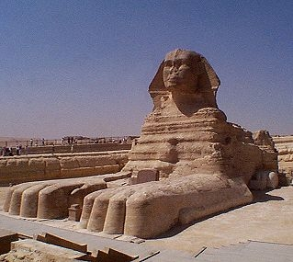
man
man displays the manual page for a command. It is a good way to learn about available flags.
For example:
% man cat?
% man head cat tail?

Slide 139
Miscellaneous Commands
man | Display manual pages for a command
gzip/gunzip | Compress / Uncompress a file
tar (-cxvf) | Combine directory(s) into one file or eXpand the file to a directory
d2u/u2d | Convert DOS and UNIX file formats
Notes:
139

Slide 140
Miscellaneous Commands
man | Display manual pages for a command
gzip/gunzip | Compress / Uncompress a file
tar (-cxvf) | Combine directory(s) into one file or eXpand the file to a directory
d2u/u2d | Convert DOS and UNIX file formats
Notes:
140

Slide 141
gzip/gunzip
Used to compress / uncompress a file.
Compressed files end with “.gz”:
% cd ~/UNIX_L1; ls co*
compfileA.gz
% cat compfileA.gz
h▒bcompfileA▒H▒▒▒W(▒/▒IQ▒A䩲
% gunzip compfileA.gz
% ls c*
compfileA
% cat compfileA
Hello world!
%
%
%
%
%
%

Slide 142
Miscellaneous Commands
man | Display manual pages for a command
gzip/gunzip | Compress / Uncompress a file
tar (-cxvf) | Combine directory(s) into one file or eXpand the file to a directory
d2u/u2d | Convert DOS and UNIX file formats
Notes:
142

Slide 143
Miscellaneous Commands
man | Display manual pages for a command
gzip/gunzip | Compress / Uncompress a file
tar (-cxvf) | Combine directory(s) into one file or eXpand the file to a directory
d2u/u2d | Convert DOS and UNIX file formats
Notes:
143

Slide 144
tar
tar packs or unpacks a directory or list of files into one file, with a .tar extension on its name.
A file with a .tar extension can be called a tarfile (and will be so-called in this class).
To pack:
tar -cvf filename.tar directoryname
To unpack:
tar -xvf filename.tar

Slide 145
An Example Using tar
% tar -xvf demo.tar
demofiles/
demofiles/abcdfeghijklmno.txt
demofiles/demo2/
demofiles/demo2/ABCD
demofiles/demo2/ABD.txt
demofiles/demo2/ACE
demofiles/demo2/Afile
demofiles/demo2/AFILE2
demofiles/demo2/AFILE3
demofiles/demo2/APROG.c
demofiles/demo2/APROG.x
demofiles/demo2/Aqrst.txt
demofiles/demo2/AZZZ
demofiles/demo2/countFiles
demofiles/demo2/count_A_files
demofiles/demo2/square.c
demofiles/demo2/square.x
demofiles/demo2/tempfile2
…
It creates this new directory, demofiles, because that was the directory that I tarred up on my computer at home.
Notes:
145

Slide 146
Miscellaneous Commands
man | Display manual pages for a command
gzip/gunzip | Compress / Uncompress a file
tar (-cxvf) | Combine directory(s) into one file or eXpand the file to a directory
d2u/u2d | Convert DOS and UNIX file formats
Notes:
146

Slide 147
Miscellaneous Commands
man | Display manual pages for a command
gzip/gunzip | Compress / Uncompress a file
tar (-cxvf) | Combine directory(s) into one file or eXpand the file to a directory
d2u/u2d | Convert DOS and UNIX file formats
To understand this one, let’s get some background on file formats…
Notes:
147

Slide 148
Windows text files are formatted differently than UNIX text files
UNIX puts a ‘\n’ character at the end of each line
Windows puts ‘\r’ and then ‘\n’ at the end of each line
(The UNIX format makes more sense, because you don’t need two characters to do the job of one.)
This problem arises if you:
Download a text file that is in Windows format
Or if you create the file in Windows, then save it into Cygwin

Slide 149
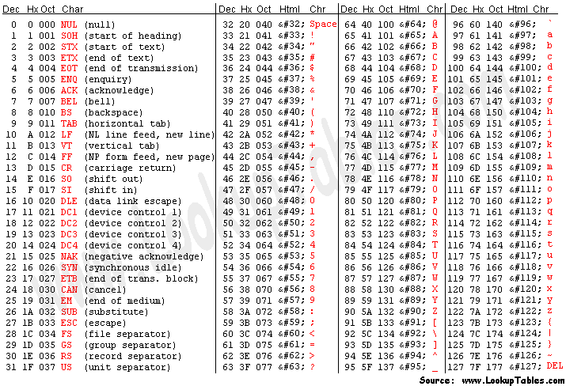
ASCII codes for \n and \r
‘\n’ is also called the line feed character (LF).
‘\r’ is called the carriage return character (CR).
Typewriters once had carriages.
The meaning of a carriage return is: “go to the beginning of the line, but don’t go down a line.”

Slide 150
cd ~/UNIX_L1/subdir3
cat filewithLFs
1234567890
abcdefgh
ABCDEF
xyz
cat filewithCRLFs
1234567890
abcdefgh
ABCDEF
xyz
cat filewithCRs
zDEFgh90
ls -l
total 3
-rw-r--r-- 1 Me None 35 Feb 13 20:25 filewithCRLFs
-rw-r--r-- 1 Me None 31 Feb 13 20:27 filewithCRs
-rw-r--r-- 1 Me None 31 Feb 13 20:25 filewithLFs
%
%
%
%
%
%
%
Each line of this file ends with \n.
(In other words, it is UNIX format.)
Unix format, so
of course UNIX can
display it correctly.
Each line of this file ends with \r\n.
(In other words, it is DOS format.)
Looks OK. Why?
Because \r goes left, then
\n goes down AND left, but
going left twice ends up
looking the same as doing it once.
Each line of this file ends with \r.
(In other words, it is MAC format.)
What is
this mess?
I'll hit
"enter"
now…
Why is my cursor here?
See that this file is 4 characters bigger, as
each of its 4 lines ends
with 2 characters
(instead of just 1).
Let us see what these three files look like when viewed with nano and with emacs…

Slide 151
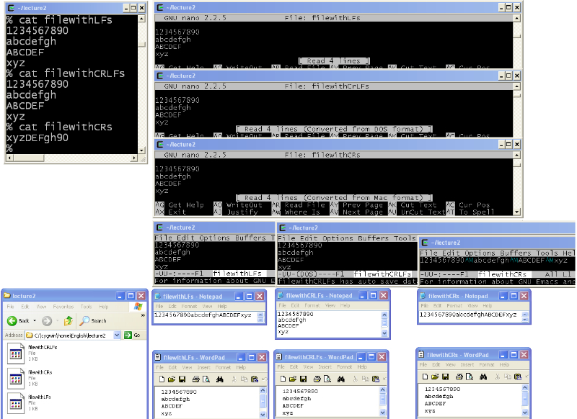
~/UNIX_L1/subdir3
Notepad only displays the DOS-format file (filewithCRLFs) correctly. It just ignores LF and CR when by themselves. (Some versions of Notepad might display them as little black squares).
~/UNIX_L1/subdir3
^M is how emacs indicates a carriage return character (emacs makes this display choice because there is no natural way to show the user that an unprintable character is in the file).
And it says filewithCRs was converted from MAC format.
~/UNIX_L1/subdir3
Wordpad always displays correctly.
So, if you want to edit you UNIX files in Windows, Wordpad is a good choice to use.
Wordpad always displays correctly.
So, if you want to edit you UNIX files in Windows, Wordpad is a good choice to use…
~/UNIX_L1/subdir3
~/UNIX_L1/subdir3
But look! Nano is displaying a message that filewithCRLFs was converted from DOS (i.e., Windows) format.
~/UNIX_L1/subdir3
The 3 nano displays all look identical. Each has 4 lines. So, indeed, that third file was not as small as it had seemed.
The 3 nano displays all look identical. Each has 4 lines. So, indeed, that third file was not as small as it had seemed.
The 3 nano displays all look identical. Each has 4 lines. So, indeed, that 3rd file was not as small as it had seemed.
subdir3
Let us see what these three files look like when viewed with nano and with emacs…
…\UNIX_L1\subdir3
Two of the emacs displays look identical, with 4 lines each.
Two of these emacs displays look identical, with 4 lines each.
But the third is all on one line and has these colorful ^M symbols

Slide 152
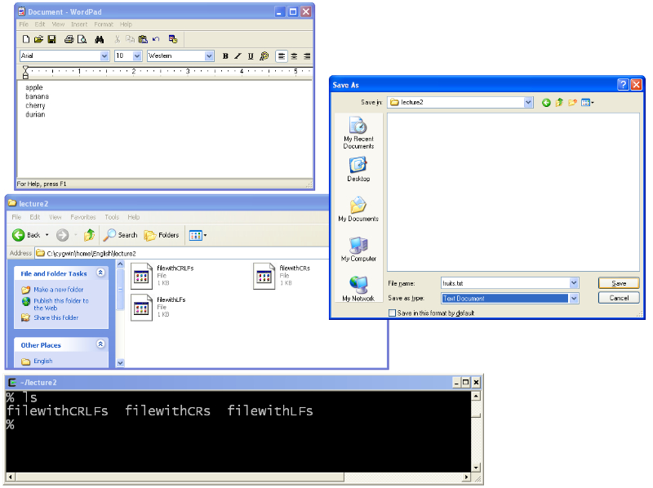
Let’s try it. Create a file with Wordpad.
I have to select Text Document. (When I did so it immediately put a .txt on my file whether I want it or not.)
So, let’s click the save button and then refresh the directory views...
I had to click around to get the desired folder, underneath C:\Cygwin\home\...
subdir3
subdir3
C:\cygwin\home\Me\UNIX_L1\subdir3
I haven’t saved it yet. That is why the file is not showing up in the directory.
~/UNIX_L1/subdir3

Slide 153
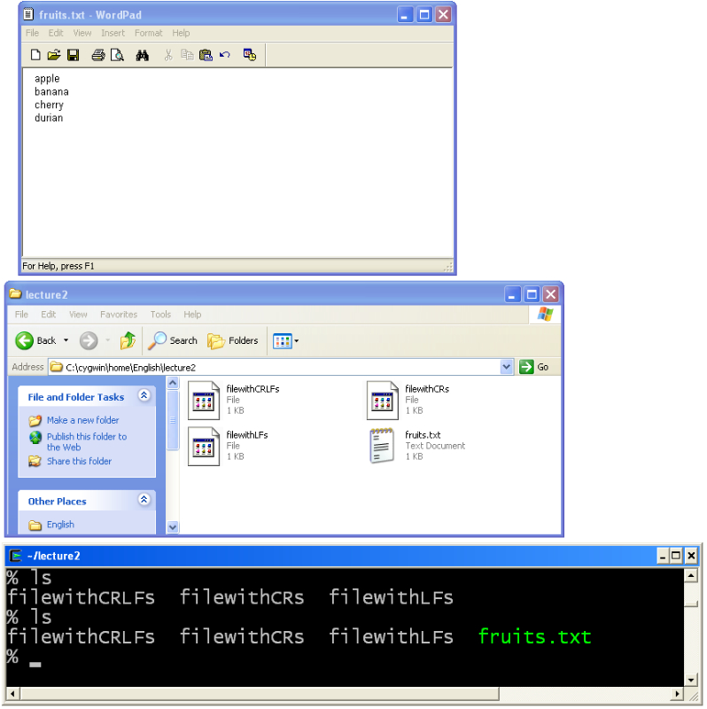
Let’s try it. Create a file with Wordpad.
So it is in the directory now. But it is DOS format and it has the “.txt” in it.
subdir3
C:\cygwin\home\Me\UNIX_L1\subdir3
Now I’ve saved it. That is why the file is showing up in the directory.
~/UNIX_L1/subdir3

Slide 154
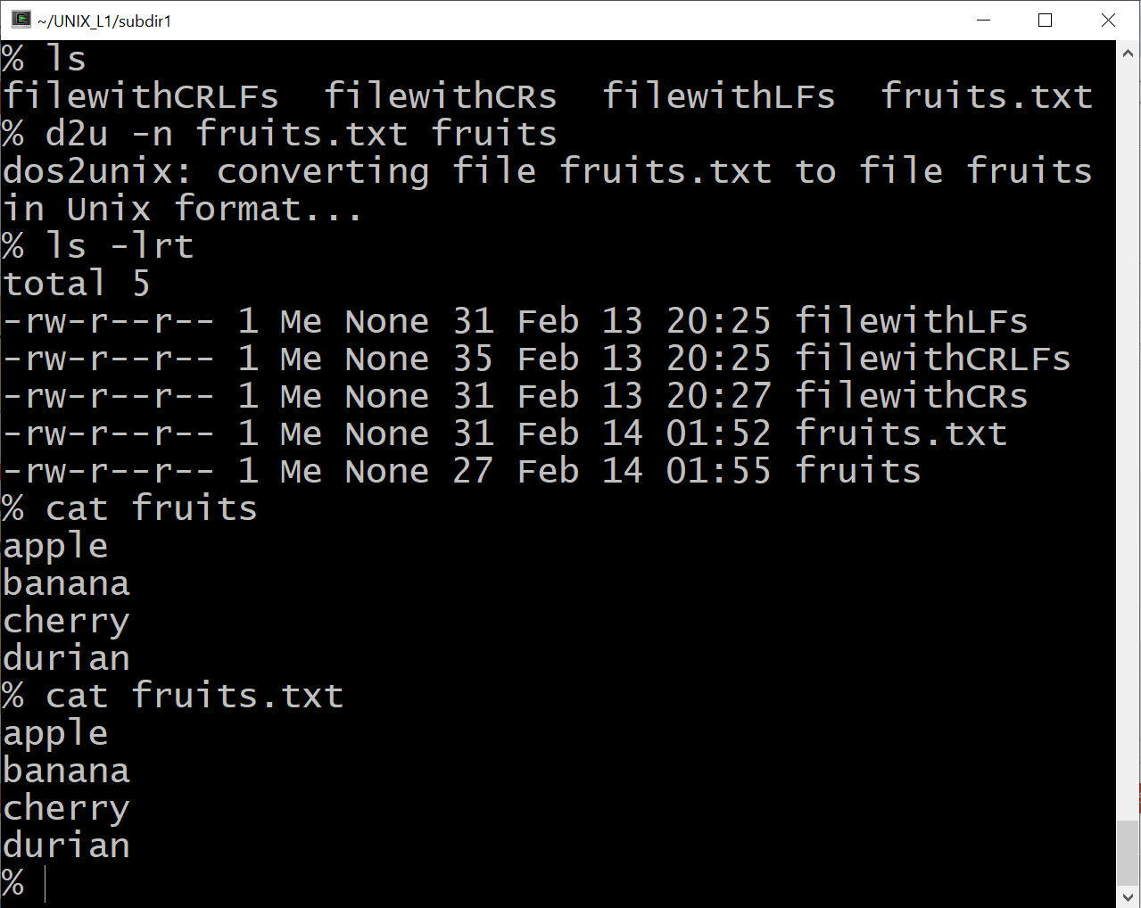
Fixing the format with d2u
But wait! Why does the old one also display correctly? It is because the cat program isn’t affected by the different format (but some other commands will be affected.)
When you install Cygwin you should obey my instructions to select the dos2unix tool.
You have to remember the -n flag. The 1st argument is the old filename. The 2nd argument is the new (unix formatted) filename.
So it worked. See how the new file is 4 bytes smaller.
Yep, it worked. The file displays correctly.

Slide 155
Homework
Set up linux on whatever computer you want
It can be an ssh into a UNIX system.
It can be a boot partition on your computer.
It can be on a bootable USB memory stick.
It can be the Linux Subsystem in Windows 10: https://docs.microsoft.com/en-us/windows/wsl/install-win10
It can be a Cygwin terminal.
When installing, make sure that you select the options to:
Under “Shells,” select to install tcsh
Under “Utils,” select to install ncurses & dos2unix
Under “Editors,” select to install emacs & nano
Under “Devel,” select to install gcc-core, gcc-g++, make, & python
This is a good option. Use this website and google to learn how to use it.
This is how I run UNIX. Cygwin is free. Use google to learn about it.
Actually, whichever UNIX/linux you use, make sure that tsch, dos2unix, and emacs, at least, are installed.
We won't use gcc,
make, or python, but
include them anyway, just so you have them.

